Slide 1
Spring MVC Tag Library & Formatter
Do Less and Accomplish More

Slide 2
Spring MVC Form Tag Library
Facilitates the development of JSP pages
Integrated with Spring MVC data binding features
Each tag provides support for the set of attributes of its corresponding HTML tag counterpart, making the tags familiar and intuitive to use.
Access Form Tag Library:
<%@ taglib prefix="form" uri="http://www.springframework.org/tags/form" %>

Slide 3
Spring MVC data binding
Built-in Data Binding handles simple String to data type conversions
HTTP request parameters [String types] are converted to model object properties of varying data types.
As a result:
  Data binding makes form beans obsolete
  Any object can be a command AKA a form-backing object
  Can bind directly to business domain objects.
  Domain objects exist as POJOs
The Spring MVC Form tag library makes it easy to bind form elements to model data with JSP pages As Binding function is ALREADY there.

Slide 4
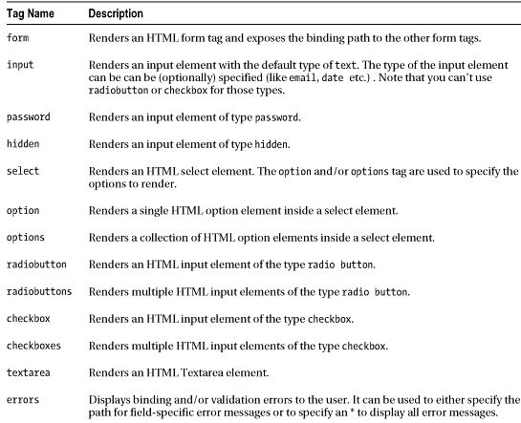
Form Tag Library
Spring Form Tag Library

Slide 5
Form Tag
This tag renders an HTML 'form' tag and exposes a binding path to inner tags for binding. All the other tags in this library are nested tags of the form tag.
1. From controller forward to JSP page which contains Spring Form Tag
@RequestMapping(value = "/addBook", method = RequestMethod.GET)
public String inputBook(@ModelAttribute("newBook") Book book, Model model) {
return "BookAddForm";
}
2. Use Spring Form tag in JSP page: BookAddForm.jsp
<form:form modelAttribute="newBook" action="addBook" method="post">
OR
<form:form commandName="newBook" action="addBook" method="post">
3. Save data in Controller
@RequestMapping(value = "/addBook", method = RequestMethod.POST)
public String saveBook(@ModelAttribute("newBook") Book book) {
  bookService.save(book);
  return "redirect:/book_list";
}
public String inputBook(Model model) {
model.addAttribute("newBook", new Book());
return "BookAddForm";
}

Slide 6
Form Tag (cont.)
@RequestMapping(value = "/add", method = RequestMethod.GET)
public String getAddNewProductForm(@ModelAttribute("newProduct") Product product) {
@RequestMapping(value = "/add", method = RequestMethod.POST)
public String processAddNewProductForm(@ModelAttribute("newProduct") Product productToBeAdded ) {
<form:form modelAttribute="book">
Request Mapping can be differentiated by RequestMethod Type
No need for Method as Post is “assumed” [Spring]
No need for Action as long as GET & Post have same URI [HTML 4]
ALSO, by default, Spring IGNORES Suffixes
/add.do will match to
@RequestMapping(value = "/add", method = RequestMethod.POST)

Slide 7
Form Tag Binding Algorithm
For “Get” Method, Looks in model map for key: “newBook”
If it doesn’t find the key – error is thrown.
@RequestMapping(value = "/addBook", method = RequestMethod.GET)
public String inputBook(@ModelAttribute("newBook") Book book, Model model) {
return "BookAddForm";
}
<form:form modelAttribute="newBook" action="addBook" method="post">
For “Post” Method, Looks in model map for key: “newBook”
If it doesn’t find the key, does “best match” on other attributes…
@RequestMapping(value = "/addBook", method = RequestMethod.POST)
public String inputBook(@ModelAttribute("newBook") Book book, Model model)
OR
public String inputBook(Book book,Model model)

Slide 8
@ModelAttribute
Can be placed on a method parameter:
@RequestMapping(value = "/addBook", method = RequestMethod.POST)
public String saveBook(@ModelAttribute("newBook") Book book) {}
  The Object should be retrieved from the model or instantiated if doesn’t exist. The Object fields should be populated from all request parameters that have matching names.
Can be placed on method. Method invoked before methods annotated with @RequestMapping
@ModelAttribute("books")
List<Book> addBookList(Model model) {
return bookService.getAllBooks();
}
Object is added to Model – in this example the List of books is added

Slide 9
Form examples with HTML output
<form:input id="title" path="title"/>
Generated HTML:
<input id="title" name="title" type="text" value=""/>
When categories is a LIST
<form:select id="category" path="category.id"
items="${categories}" itemValue="id" itemLabel="name" />
Generated HTML:
<select id="category" name="category.id">
<option value="1" selected="selected">Computing</option>
<option value="2">Travel</option >
<option value="3">Health</option >
</select>
NOTE: path is the “binding Path” defined previously
If category.id already has a value,
Then it will be market as selected

Slide 10
Form example with HTML output [Cont.]
<form:select id="category" path="category.id">
<form:option value="0" label="--Select Category"/>
<form:options items="${categories}" itemLabel="name" itemValue= "id"/>
</form:select>
Generated HTML:
<select id="category" name="category.id">
<option value="0" selected="selected">--Select Category</ option >
<option value="1">Computing</ option >
<option value="2">Travel</ option >
<option value="3">Health</option>
</select>
When categories is a MAP
<form:select path="category.id" items="${categoriesMap}" />
Automatically Yields:
<option value="1">Computing</ option >
Where “1” is the Map key

Slide 11
General Purpose Spring Tag Library
Not Spring MVC specific
Available to any Java Server Page used in the Spring Framework
Tags for evaluating errors, setting themes and outputting internationalized messages.
<%@ taglib prefix="spring" uri="http://www.springframework.org/tags"%>

Slide 12
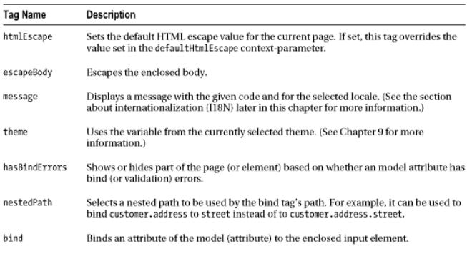
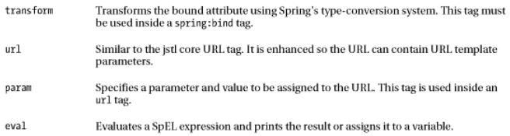
Spring Tag Library

Slide 13
Message Tag
Internationalization support through externalization of messages
Text from MessageSource configured in WebApplicationContext
<spring:message code="greeting" text="Hi" />
“code” isn’t set or cannot be resolved, “text” will be used as default message.
Also, the spring:message- tag, works with the locale support that comes with Spring. [ Internationalization]

Slide 14
Spring [externalize] message tag example
Dispatcher Servletconfiguration file declares message source bean. “messages” file is messages.properties and must reside in the source class path in order to be discovered.
springmvc-config.xml
<bean id= "messageSource"
class="org.springframework.context.support.ResourceBundleMessageSource">
<property name="basenames" value="message2,messages"/>
</bean>
WebApplicationContextConfig.java
@Bean
public MessageSource messageSource() {
  ResourceBundleMessageSource resource = new ResourceBundleMessageSource();
  resource.setBasename("messages");
  return resource;
}
Spring message tag accesses label name from resource file messages.properties
<label for="bookList"><spring:message code="book.book" /> </label>

Slide 15
Spring URL Tag
Spring URL tag
Access static resources: Resolves the path from context root - irrespective of current URL.
  <link rel="stylesheet" type="text/css" href="<spring:url value="/css/main.css"/>">
  Resolved to:
  <link rel="stylesheet" type="text/css" href="/Book_Tag_Formatter/css/main.css">
Query Parameter Passing:
  <spring:url value="/addBook" var="addBook_url" >
  <spring:param name="ISBN" value="1234"/>
  </spring:url>
  <a href="${addBook_url}">Add Book</a>
  Resolved to:
  <a href="/Book05a/addBook?ISBN=1234">Add Book</a>
Spring Template /@PathVariable
  <spring:url value="/book_edit/{id}" var="edit" >
  <spring:param name="id" value="${book.id}" />
  </spring:url>
  <a href="${edit}">Edit</a>
  Resolved to:
  <a href="/Book05a/book_edit/2">Edit</a>
Just Like JSTL URL

Slide 16
Main Point
The Spring MVC tag library facilitates JSP development with specialized Form tags.
The practice of the TM technique, by structuring the laws of nature in one’s life makes everything go more smoothly.

Slide 17
Excluding Fields from Data Binding
We don’t always want to bind our ENTIRE domain object. For example, an internal Customer or Product ID
Need to explicitly restrict binding on specific fields
WebDataBinder object used by the binding function
@initBinder annotation identifies Controller method that accesses WebDataBinder
@InitBinder
public void initialiseBinder(WebDataBinder binder) {
//binder.setDisallowedFields("title");
binder.setAllowedFields("isbn", "title", "category.id", "author", "publishDate");
}
Notes:
binder.setRequiredFields(“name”,”description”,”price”);
binder.setDisallowedFields("productImage", "userManual");

Slide 18
Custom Data Binding
Built-in Data Binding handles simple String to data type conversions.
Custom Binding is needed to handle more complex cases.
Three Options in Spring MVC:
  CustomPropertyEditor
    Old-style [“retro”] ,heavyweight based on entire java.beans package
  Converter
    General-purpose type conversion system introduced Spring 3.0. used internally by Spring. One way conversion, locale agnostic
  Formatter
    Designed for Spring MVC form conversion. 2 way conversion - to & from String. Locale aware. More lightweight that Converter.

Slide 19
Out-of-the-box Spring Formatters
The Number Package:
NumberFormatter,
CurrencyFormatter
PercentFormatter
The DateTime Package:
DateFormatter API
Custom Examples [NOT out-of-the-box]:
ISBN Number
Multiple Select List – collection of Objects
Notes:
http://www.logicbig.com/tutorials/spring-framework/spring-web-mvc/spring-formatter-annotation/

Slide 20
ISBN Formatter Example
public class ISBNFormatter implements Formatter<ISBNumber> {
public String print(ISBNumber isbn, Locale locale) {
return isbn.getStart() + "-" +
isbn.getMiddle() + "-" + isbn.getEnd();
}
public ISBNumber parse(String source, Locale locale)
throws ParseException {
int start = Integer.parseInt(source.substring(0, 3));
int middle = Integer.parseInt(source.substring(4, 7));
int end = Integer.parseInt(source.substring(8, 11));
return new ISBNumber(start, middle, end);
}
}

Slide 21
Formatter Configuration
<mvc:annotation-driven conversion-service="conversionService"/>
<bean id="conversionService" class=
"org.springframework.format.support.FormattingConversionServiceFactoryBean">
<property name="formatters">
<set>
<bean class="mum.edu.formatter.ISBNFormatter"> </bean>
</set>
</property>
</bean>

Slide 22
Multiple Select Formatter
/**
* If a Book referenced in a Form by the String value of its ID
* it is converted into an Object & Vice-versa
*/
@Component
public class BookFormatter implements Formatter<Book> {
  @Autowired
  private BookService bookService;
  public Book parse(String text, Locale locale) throws ParseException {
  return bookService.get(Long.valueOf(text));
  }
  @Override
  public String print(Book object, Locale locale) {
  return String.valueOf(object.getId());
  }
}
Notes:
http://www.kscodes.com/spring-mvc/spring-mvc-select-tag-example/
Trivial select

Slide 23
Main Point
Spring Data binding automatically binds form elements to Model data. Spring MVC tag library makes this easy with JSP Form tags. For specialized [ complex] cases, Spring MVC provides the custom Formatter interface
The practice of the TM technique, in a simple automatic way structures communication between outer and inner values enlivening all aspects of life.

